Slide 1
Was T.rex just a big chicken computational proteomics
Professor :Dr.Reza Rezazadegan
Narges khalifat
Niloofar shahabi

Slide 2
story
Jack Horner had serious difficulties with reading and mathematics as a child, and later in life he was diagnosed with dyslexia. Despite this, he had a strong passion for dinosaurs. Even though he failed academically and dropped out of college, he eventually became one of the most famous paleontologists in the world and inspired characters in Jurassic Park.
For a long time, paleontology was mostly a descriptive science and did not depend much on mathematics or computation. That changed when Horner discovered a 68-million-year-old Tyrannosaurus rex fossil. A small piece of this fossil was later analyzed, and surprisingly, remnants of ancient proteins were found.
Scientists used mass spectrometry to analyze these protein fragments, called peptides. After analyzing thousands of spectra, they discovered that the peptides from T. rex were very similar to chicken peptides. This provided the first molecular evidence that modern birds evolved from dinosaurs.
This story shows how computational methods and algorithms are essential for answering biological questions that cannot be solved by traditional methods alone

Slide 3
Peptide Identification and the T. rex Proteome
The process of confirming that a peptide from a known proteome is present in a sample is called peptide identification.
But the question is: how can we form a T. rex proteome?
Although peptide identification dominates modern proteomics studies, the proteomes of many species—including extinct species like T. rex—remain unknown.
In such cases, biologists rely on de novo peptide sequencing, which means inferring the amino acid sequence of a peptide without relying on a known proteome. This is exactly where we start.
Suppose a sample contains a large number of identical copies of a peptide—typically from millions of cells. A mass spectrometer breaks each copy into two smaller fragments, and different copies of the same peptide may break differently.
Example: One copy of the peptide REDCA may break into RE and DCA, while another copy may break in RED and CA. The fragments RE and RED are called prefixes of REDCA, whereas DCA and CA are called suffixes of REDCA.

Slide 4
🧪 Mass Spectrometry
"Main Goal"
Mass spectrometry is used to identify peptides and proteins in a sample.
We can’t see proteins directly, but we can measure the mass of their small fragments.
Each peptide has a unique mass, which helps infer its possible amino acid sequence.
"How It Works"
Peptide Sample:
Millions of copies of a peptide exist in a sample (from millions of cells).
Fragmentation:
The mass spectrometer breaks each peptide into smaller fragments.
Different copies of the same peptide may break differently.
Example: the peptide REDCA may break into RE + DCA or RED + CA.
Prefixes and Suffixes:
First fragments (RE, RED) → prefixes
Last fragments (DCA, CA) → suffixes
Mass Measurement:
The spectrometer records the integer mass of each fragment.
Using all prefixes and suffixes, we can create an ideal spectrum.

Slide 5
spectrum
What does an Ideal Spectrum represent? For a given peptide:
We consider all prefixes (fragments starting from the beginning)
And all suffixes (fragments ending at the end)
We compute the mass of each prefix and suffix. The collection of all these masses is called the ideal spectrum of the peptide.
Because different fragments can have the same mass, duplicate masses are allowed and expected in an ideal spectrum.
What does it mean for a peptide to “explain” a spectrum? This is a formal definition used in algorithms:
A peptide explains a spectrum if the ideal spectrum generated from that peptide is exactly the same as the given spectrum from the experiment.
In other words:
If the masses predicted from a peptide perfectly match the observed masses,
Then that peptide could be the true source of the spectrum.

Slide 6
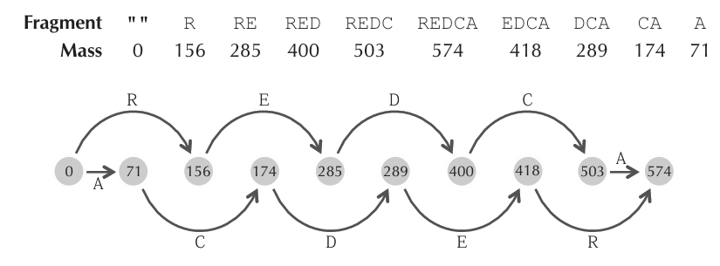
Graph-Based Decoding Peptides
We would like to separate the masses in a spectrum into those derived from prefixes and suffixes, but it is unclear how to do this.
Instead, we note that if two masses differ by the mass of a single amino acid, then they likely correspond to two prefixes (or two suffixes) that differ by only one amino acid.
For example, we do not directly know that the masses 400 and 503 correspond to the prefixes RED and REDC (Figure 11.3, top). However, we can hypothesize that because the difference between these masses is 103 (the mass of amino acid C), these masses correspond to prefixes or suffixes that differ by a single C.
This idea motivates a graph-based approach for solving the Decoding an Ideal Spectrum problem.
We represent the masses in a spectrum as a sorted sequence of integers, Spectrum = s₁, …, sₘ, where:
s₁ = 0
sₘ is the total mass of the (unknown) peptide
We then define a labeled graph called GRAPH(Spectrum):
Create a node for each element in Spectrum
Connect two nodes sᵢ and sⱼ with a directed edge labeled by an amino acid a if the mass difference (sⱼ − sᵢ) equals the mass of amino acid a

Slide 7
From Ideal to Real Spectra
"Difference between Ideal and Real Spectra"
Ideal spectrum: All peaks and masses exactly match the peptide; analysis is straightforward.
Real spectrum: More complex and challenging because:
Noise can create false peaks
Some peptide bonds rarely break → some true peaks may be missing
Peak intensities can vary significantly
"How Real Spectra Are Produced"
Each peptide is broken into smaller fragments.
The mass spectrometer ionizes these fragments → charged ions are produced.
The device measures:
m/z (mass-to-charge ratio) → x-axis
Intensity (number of ions at that m/z) → y-axis
Visual example:
Tall peak → many ions
Short peak → few ions
Peak position on x-axis → relative mass of the ion

Slide 8
"Limitations and Solutions"
Mass spectrometers cannot detect all m/z values → analyzing entire proteins is difficult.
Solution: Proteins are first cut into shorter peptides using trypsin:
Trypsin cuts after amino acids R and K
Average peptide length ≈ 14 amino acids
"Annotating a Real Spectrum"
Once the peptide generating the spectrum is inferred, peaks can be labeled:
Peaks corresponding to prefixes → bᵢ
Peaks corresponding to suffixes → yᵢ
This helps identify which part of the peptide each peak represents.
"Challenges in Real Spectrum Analysis"
Peaks may be missing or misleading → identifying the correct peptide is harder.
Intensity varies greatly:
Some bonds break frequently → tall peaks
Some bonds rarely break → short or missing peaks
Unlike ideal spectra, real spectra require careful consideration of both peak positions and intensities.

Slide 9
Example: T. rex
DinosaurSpectrum is a real spectrum obtained from a T. rex bone.
Two possible peptide interpretations:
ATKIVDCFMTY
GLVGAPGLRGLPGK
Analysis must consider:
Peak positions (m/z)
Peak intensities
Missing or noisy peaks

Slide 10
Key Takeaways
Real spectra are always more complex and noisy.
Accurate peptide reconstruction requires considering both peak positions and intensities.
Cutting proteins into shorter peptides with trypsin makes analysis feasible.
Annotating peaks as bᵢ (prefixes) and yᵢ (suffixes) is essential to map fragments to the peptide sequence.

Slide 11
Challenges in Real Mass Spectrometry
The issue of false or missing masses is just one of many challenges in mass spectrometry.
When a mass spectrometer fragments a peptide, small parts of the resulting fragments can be lost, which reduces their measured mass.
For example, if the peptide REDCA is broken into RE and DCA:
RE may lose a water molecule (H₂O) → mass decreases by 18
DCA may lose an ammonia molecule (NH₃) → mass decreases by 17
The resulting integer masses become:
MASS(RE) − 18
MASS(DCA) − 17
Because of the practical complications in mass spectrometry, we make some simplifying assumptions to model peptide sequencing computationally:
All different fragmentation patterns are treated as noise.
All peaks are assumed to have charge +1.
Spectra are discretized, meaning all masses are treated as integers.
These assumptions allow us to focus on the main computational problem without being overwhelmed by all the real-world experimental details.

Slide 12
Peptide Scoring Against Spectra
Goal: Find the peptide that best matches a mass spectrum.
Example:
Peptide: XZZXX
Amino acid masses: X = 4, Z = 5
Prefix masses: 4, 9, 14, 18, 22
Suffix masses: 22, 18, 13, 8, 4
Hypothetical spectrum (intensities at each mass):
(0,0,0,3,8,7,2,1,100,0,1,4,3,500,2,1,3,9,1,2,2,0)
Scoring methods:
Intensity Count – sum of intensities of all peaks annotated by the peptide.
Problem: very tall peaks (e.g., 100, 500) can dominate and may be noise.
Shared Peaks Count – count of peaks above a threshold (e.g., intensity > 5).
Advantage: reduces impact of extreme peaks (noise).
Example: XZZXX → 4 shared peaks
Key point:
Shared peaks count works better than intensity sum, but still not perfect.
Best scoring methods balance all peak intensities without letting the tallest peaks dominate.

Slide 13
Vector Representation of Peptides
To compare peptides with spectra, we convert both into vectors and define a scoring function as the dot product of these vectors.
For a peptide Peptide = a₁a₂…aₙ of length n, we represent its prefix masses as a binary vector of length MASS(Peptide).
Positions corresponding to prefix masses are set to 1.
All other positions (noise) are set to 0.
Example:
Peptide: XZZXX
Amino acid masses: X = 4, Z = 5
Prefix masses: 4, 9, 14, 18, 22
Binary peptide vector (length = 22, total mass of peptide):
(0, 0, 0, 1, 0, 0, 0, 0, 1, 0, 0, 0, 0, 1, 0, 0, 0, 1, 0, 0, 0, 1)

Slide 14
Scoring Peptides Against Spectra
After transforming a peptide Peptide into a peptide vector ,peptide =(p1,…pm)
and a spectrum Spectrum into a spectral vector , Spectrum=(s1,…sm)
of the same length, we define the score of the peptide against the spectrum as the dot product of the two vectors:
SCORE(Peptide, Spectrum) is essentially an “amplitude count”, which sums the amplitudes in the spectral vector that are annotated by the peptide.
Unlike a simple intensity count, this method does not get dominated by very high-intensity peaks, because the spectrum has been transformed into a spectral vector of amplitudes.

Slide 15
How It Works
Peptide vector: marks the positions (masses) corresponding to the peptide’s prefixes.
Spectral vector: contains the amplitudes (transformed intensities) of the peaks in the spectrum.
Dot product: multiplies each position in the peptide vector by the corresponding amplitude in the spectral vector and sums them, giving the total score.
Example:
Suppose a peptide has prefix masses at positions 4, 9, 14, 18, 22, and the spectral vector has amplitudes at these positions.
The score is calculated by summing the amplitudes at these positions, which reflects how well the peptide explains the spectrum.
🔹 Advantages
High-intensity peaks contribute to the score but do not dominate it.
The score effectively measures how well a candidate peptide matches the observed spectrum.
Using spectral vectors simplifies computations and reduces bias caused by extremely high-intensity peaks.
In short: Transforming peptides and spectra into vectors and using the dot product as a score provides a robust, fair, and computationally efficient method for matching peptides to mass spectra.

Slide 16
Spectral Vectors and Peptide Scoring
In the remainder of this chapter, we work with spectral vectors rather than raw mass spectra. Representing spectra as vectors makes peptide–spectrum comparison more systematic and allows the use of simple mathematical operations for scoring.
Given a spectral vector Spectrum, the objective is to find a peptide Peptide that maximizes the scoring function SCORE(Peptide, Spectrum), which measures how well the peptide explains the observed spectrum.
Since a peptide can only generate a spectrum with the same parent mass, the peptide vector must have the same length as the spectral vector. This length corresponds to the total mass of the peptide. To strictly enforce this physical constraint, the score between a peptide vector and a spectral vector of different lengths is defined as negative infinity (−∞). As a result, peptides whose masses do not match the spectrum are automatically excluded from consideration.

Slide 17
Node Weights and Practical Application
Node Weights:
Each node is assigned a weight equal to its corresponding value in the spectral vector, reflecting the intensity observed at that mass.
The source node (0) has a weight of zero, since it represents the starting point with no accumulated mass.
Practical Application:
The DAG allows us to find highest-weight paths, which correspond to the most likely peptide sequences matching the given spectrum.
By maximizing the total weight along a path, we can identify the peptide whose theoretical spectrum best fits the observed data.

Slide 18
Peptide Identification
Main Challenge in Peptide Sequencing:
When we have a mass spectrum (e.g., DinosaurSpectrum), the initial idea might be that the peptide with the highest score is the one that produced the spectrum.
In practice, no scoring function can reliably assign the highest score to the true peptide.
This is because spectra are often noisy, and observed peaks may not perfectly match the theoretical model. Other peptide combinations may also achieve similar high scores.
Solution: Limiting the Search Space:
Searching among all possible peptides in the universe is impractical and reduces accuracy.
Fortunately, if we restrict our search to peptides present in the species’ proteome, the correct peptide usually has the highest score within this limited set.
This key insight allows us to move from general peptide sequencing to species-specific peptide identification.
Advantages of This Approach:
Reduced search space: Only biologically possible peptides are considered; impossible ones are ignored.
Increased accuracy: The true peptide is more likely to have the highest score.
Practical application: This approach is the basis of most modern peptide identification algorithms in bioinformatics and proteomics.

Slide 19
Peptide Identification and Peptide-Spectrum Matches (PSMs)
Approximately 90% of proteins in animal bones are collagen, and dinosaur bones undoubtedly contained collagen. The likelihood of other proteins surviving for millions of years is extremely low. Since collagen sequences are often conserved across species, Asara reasoned that any surviving proteins in the T. rex fossil would likely be similar to collagens from present-day species.
As a sanity check, Asara compared the T. rex spectra against the entire UniProt database, which contains proteins from hundreds of species, totaling nearly 200 million amino acids. He also included mutated versions of modern collagens to model potential differences between these collagens and those in T. rex, creating an extended database called UniProt+.
The results showed that most high-scoring peptides in this database were chicken collagens, supporting the hypothesis that birds evolved from dinosaurs. In fact, DinosaurPeptide differs by only one mutation from a chicken collagen peptide.

Slide 20
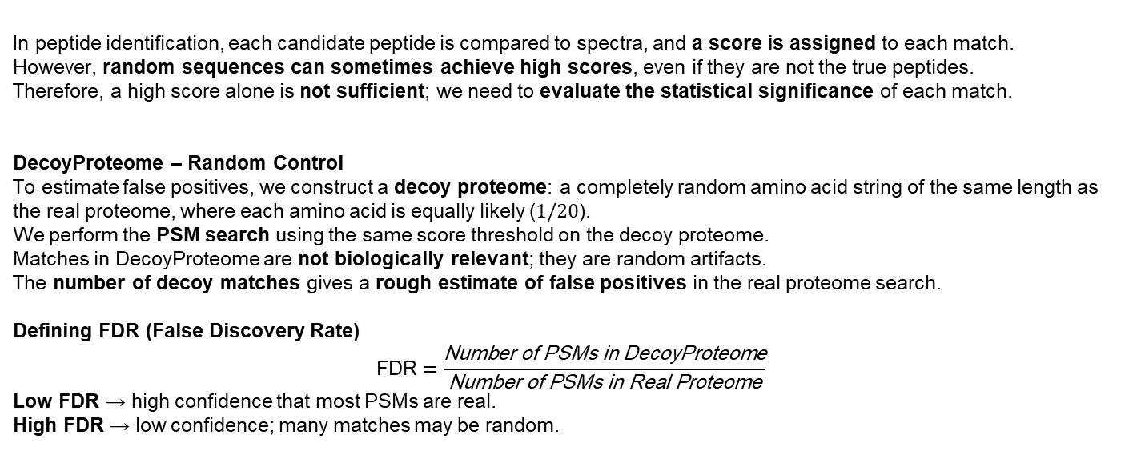
DecoyProteome and the False Discovery Rate (FDR)
In peptide identification, each candidate peptide is compared to spectra, and a score is assigned to each match.
However, random sequences can sometimes achieve high scores, even if they are not the true peptides.
Therefore, a high score alone is not sufficient; we need to evaluate the statistical significance of each match.
DecoyProteome – Random Control
To estimate false positives, we construct a decoy proteome: a completely random amino acid string of the same length as the real proteome, where each amino acid is equally likely ($1/20$).
We perform the PSM search using the same score threshold on the decoy proteome.
Matches in DecoyProteome are not biologically relevant; they are random artifacts.
The number of decoy matches gives a rough estimate of false positives in the real proteome search.
Defining FDR (False Discovery Rate)
$$\text{FDR}=\frac{\text{Number} \text{of} \text{PSMs} \text{in} \text{DecoyProteome}}{\text{Number} \text{of} \text{PSMs} \text{in} \text{Real} \text{Proteome}}$$
Low FDR → high confidence that most PSMs are real.
High FDR → low confidence; many matches may be random.

Slide 21
Example:
Search in real proteome: 100 PSMs
Search in decoy proteome: 5 PSMs → FDR = 5%, meaning ~95% of PSMs are likely valid.
If decoy search returns ~100 PSMs: → FDR ≈ 1, making it difficult to trust any identified PSM as biologically meaningful.
Connection to the Infinite Monkey Theorem:
Just as millions of monkeys typing randomly could eventually produce a coherent text, billions of random peptides can occasionally achieve high scores.
DecoyProteome helps identify these “random monkeys” and remove them from analysis.

Slide 22
Dictionary
Dictionary: a set of strings (or peptides) that are considered meaningful or important.
In peptide–spectrum matching:
The dictionary is the set of all peptides that score sufficiently high against a given spectrum.
In other words, it contains all peptides that could plausibly explain the observed spectrum.
Monkey and typewriter analogy:
Imagine a monkey typing randomly on a typewriter.
Dictionary = the set of all valid English words.
We only care about the strings that are in the dictionary.
📌 Key idea: The dictionary defines what counts as a “good candidate” without yet considering probabilities.

Slide 23
Pr(Dictionary)
Pr(Dictionary): the probability that a randomly generated string (or peptide) falls into the dictionary.
Monkey analogy:
The monkey types randomly.
Pr(Dictionary) = the probability that a randomly typed string is an actual English word (i.e., in the dictionary).
Peptide–spectrum context:
Pr(Dictionary) = the probability that a randomly generated peptide scores high enough to be in the dictionary.
Intuitive interpretation:
Large Pr(Dictionary):
High-scoring peptides (or typed English words) are fairly likely by chance.
Observing them might be due to randomness.
Small Pr(Dictionary):
High-scoring peptides (or typed English words) are very unlikely by chance.
Observing them is probably meaningful or biologically real.

Slide 24
Statistical Significance of Peptide–Spectrum Matches
• We study whether a peptide–spectrum match (PSM) is statistically significant or could occur by chance.
• A spectral dictionary is defined as the set of all peptides whose score against a given spectrum is at least a chosen threshold.
• Peptides are assumed to be generated randomly, where each amino acid occurs with probability 1/20. Probability Model Pr(Peptide) = 1 / 20^{|Peptide|}
• The probability of a spectral dictionary is the sum of probabilities of all peptides in the dictionary: Pr(Dictionary) = sum over Peptide in Dictionary of (1 / 20^{|Peptide|})
• Longer peptides are exponentially less likely under this model. Efficient Computation
• Define Pr(i, t) as the total probability of all peptides with mass i and score t.
• Removing the last amino acid reduces both the mass and the score.
• The recurrence relation is: Pr(i, t) = sum over amino acids a of (1/20) * Pr(i − mass(a), t − s_a)
• The probability of the thresholded spectral dictionary is computed as: Pr(Dictionary) = sum over t ≥ threshold of Pr(m, t) Interpretation
• Even if the dictionary contains many peptides, its total probability may be very small.
• A very small probability indicates that the observed PSM is unlikely to be random and is therefore statistically significant

Slide 25

Expected Random Peptide–Spectrum Matches
• The goal is to estimate how many peptide–spectrum matches (PSMs) are expected to occur by chance in a large protein database.
• This expectation is approximated by multiplying the database length n by the probability of the spectral dictionary:
n · Pr(Dictionary(DinosaurPSM))
• Although Pr(Dictionary(DinosaurPSM)) is very small, the large size of the UniProt+ database results in tens of thousands of expected random matches
. • Therefore, observing DinosaurPSM during a database search is not surprising.
• This suggests that DinosaurPeptide is a statistical artifact rather than a genuine T. rex peptide
. • The chapter then examines whether other reported T. rex peptide–spectrum matches are statistically significant.
• After reanalysis, some reported matches appear questionable, while others remain statistically robust.
• A notable example is a hemoglobin peptide that perfectly matches ostrich hemoglobin and is more statistically significant than previously reported collagen peptides.
• However, hemoglobins are much less conserved than collagens and differ substantially even between closely related species
. • Moreover, intact hemoglobin peptides have not been observed in much younger and more common fossils
. • These observations cast serious doubt on the hemoglobin peptide originating from T. rex.

Slide 26
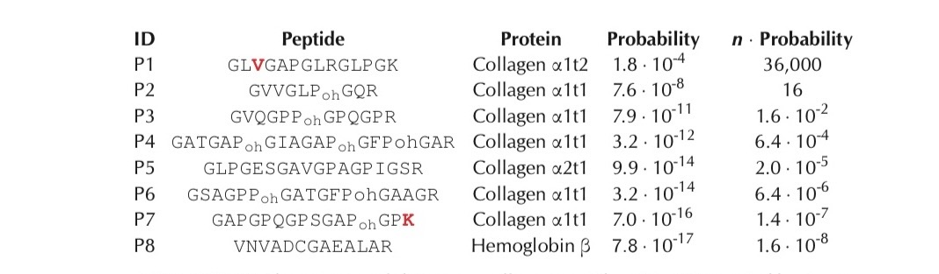
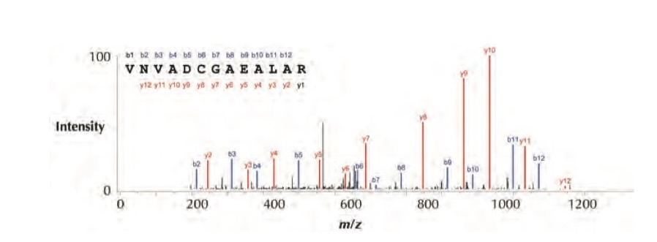

Slide 27

Re-evaluating Reported T. rex Peptides
• Several candidate T. rex peptides were reported, most of them derived from collagen.
• One peptide shows an extremely high-quality spectrum and perfectly matches ostrich hemoglobin.
• This hemoglobin match is more statistically significant than the reported collagen peptides.
• However, hemoglobins are poorly conserved and unlikely to persist in ancient fossils.
• The match is best explained by contamination (carryover) from previous ostrich samples.
• Therefore, this peptide is unlikely to represent a genuine T. rex peptide.

Slide 28
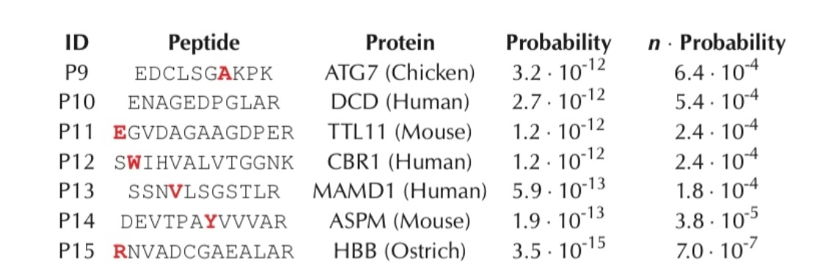

Slide 29

Evidence from Broad Database Search
• When T. rex spectra are searched against all vertebrate proteins, many peptide matches are found.
• These matches correspond to chicken, human, mouse, and ostrich proteins.
• The same spectra are therefore not specific to T. rex.
• This indicates that many matches are statistical artifacts, not genuine ancient peptides.
• As a result, the claim of molecular evidence linking T. rex to birds becomes significantly weaker.

Slide 30
Limits of Evidence and Computation
Claims about ancient biomolecules have sparked long-standing scientific controversy. Earlier reports of dinosaur DNA were later shown to result from contamination rather than genuine ancient material, demonstrating that striking scientific claims require careful validation and independent replication. Broad and early data sharing is essential for uncovering hidden issues such as contamination. The discussion then moves to a computational limitation in peptide identification. The PSMSEARCH algorithm can only identify peptides that occur exactly in a reference proteome, while real peptides may contain mutations or post-translational modifications. Enumerating all possible mutated peptides is computationally infeasible, which motivates the development of more advanced methods for identifying modified or mutated peptides.

Slide 31

Real peptides often contain post-translational modifications that alter amino acids after translation, in addition to possible mutations. Most proteins are modified in some way, and many of these modifications play essential regulatory roles, such as phosphorylation, which adds or removes a phosphate group to control protein activity. In the T. rex case, several candidate peptides include a modification that converts proline to hydroxyproline, a key component of collagen that contributes to its structural stability. From a computational perspective, a post-translational modification introduces a mass offset \delta to an amino acid (for example, +80 for phosphorylation and +16 for proline-to-hydroxyproline). As a result, identifying modified peptides becomes an alignment problem that must allow for mass shifts, motivating the development of more flexible algorithms capable of handling both mutations and post-translational modifications.

Slide 32
Spectral Alignment with Post-Translational Modifications
01
02
03Spectral Alignment Problem: Given a peptide, a spectrum, and an integer k, find the modified variant with the maximum peptide–spectrum score. Modification Search Problem: Given a spectrum and a proteome, find the peptide whose modified variants (up to k modifications) achieve the highest score. VARIANTS_k(Peptide)
Post-translational modifications change the mass of an amino acid by a value δ.
If δ > 0, the modified peptide vector differs from the original one by inserting a block of zeros;
if δ < 0, the modification corresponds to deleting a block of zeros. These operations are referred to as block indels.
Applying up to k modifications to a peptide is equivalent to applying up to k block indels to its peptide vector. We define:
VARIANTS_k(Peptide)
as the set of all modified variants of a peptide with at most k modifications.

Slide 33
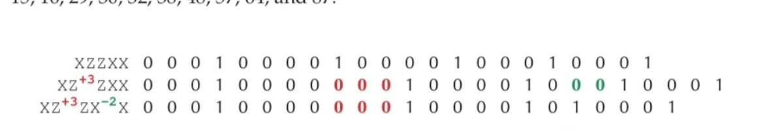
From Modifications to Spectral Alignment
Mutations can be treated in the same way as post-translational modifications by modeling them as block insertions or deletions in the peptide vector. For example, mutating one amino acid into another corresponds to a mass shift
δ = mass(new amino acid) − mass(original amino acid)
This allows the Modification Search Problem to be reformulated as a Mutation Search Problem without changing the underlying framework. Finding the highest-scoring peptide with up to k such block indels closely resembles classical sequence alignment. This observation motivates formulating the Spectral Alignment Problem as a longest path problem in a directed acyclic graph (DAG), where paths represent peptide variants aligned to a spectrum.

Slide 34
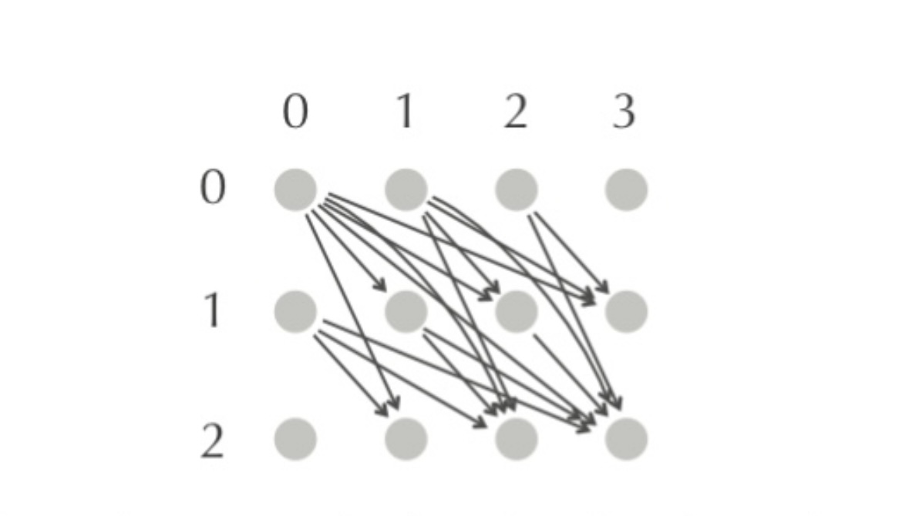
Spectral Alignment as a Longest Path Problem
• Modified peptides can be represented as paths in a 2D Manhattan grid from (0,0) to (m, m+Δ).
• Each node (i, j) represents matching prefix masses of the original peptide and its modified variant.
• Diagonal edges correspond to unmodified amino acids, while non-diagonal edges represent modifications with mass shift δ.
• Thus, each modified peptide corresponds to a path in a directed acyclic graph (DAG).
• The Spectral Alignment Problem is reduced to finding the highest-scoring (longest) path in this DAG.

Slide 35
PSM Graph for Spectral Alignment
All modified variants of a peptide with mass m + \Delta can be represented as paths from source to sink in a directed acyclic graph called SOUTHEAST(m, m+\Delta), where non-diagonal edges correspond to modifications. Not every path in this graph represents a valid modified peptide. Since the original peptide is fixed, valid paths can only pass through rows corresponding to prefix masses of the peptide. Removing all other rows yields a reduced graph called the PSM graph.
In the PSM graph, each node (i, j) is assigned a weight equal to the spectral value s_j. With this assignment, the total weight of a path equals the peptide–spectrum score of the corresponding modified peptide.
Therefore, spectral alignment reduces to finding a maximum-weight path in the PSM graph, subject to at most k non-diagonal edges (i.e., modifications).

Slide 36
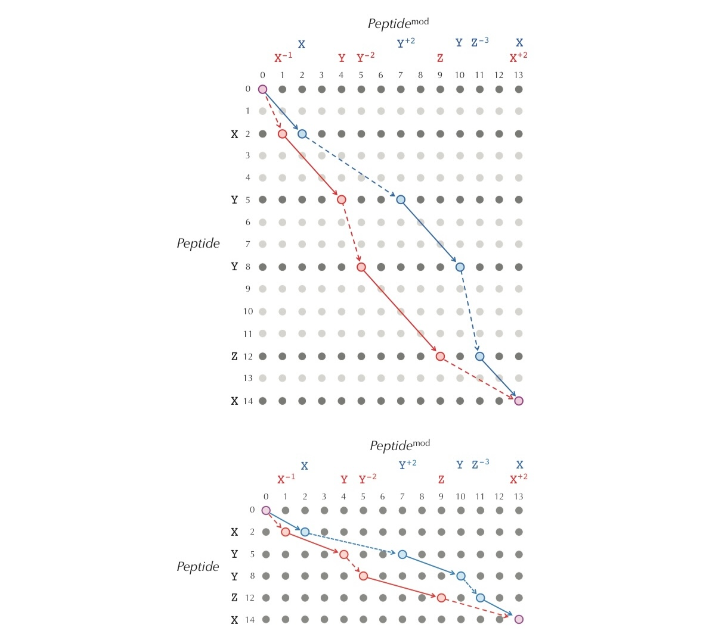
Spectral Alignment as a Graph Path Problem Modified peptides can be represented as paths in a directed
Modified peptides can be represented as paths in a directed acyclic graph (DAG). Each path goes from the source to the sink and corresponds to one peptide variant.
Diagonal edges represent unmodified amino acids. Non-diagonal edges represent mutations or modifications (mass shifts).
By keeping only valid rows, the graph is reduced to the PSM graph. Finding the best modified peptide is equivalent to finding the maximum-weight path with at most k non-diagonal edges.

Slide 37
Spectral Alignment Algorithm
To handle the constraint of at most k modifications, the 2D PSM graph is expanded into a 3D spectral alignment graph with k+1 layers.
Each layer represents the number of modifications used so far. Diagonal edges stay within the same layer, while non-diagonal edges move to the next layer.
Every path from (0,0,0) to (m, m+Δ, t) corresponds to a peptide with t modifications. Thus, spectral alignment reduces to finding a maximum-weight path in this layered DAG.
We define SCORE(i, j, t) as the maximum score of all paths from the source to node (i, j, t). The optimal peptide score is the maximum SCORE(m, m+Δ, t) for 0 ≤ t ≤ k.

Slide 38
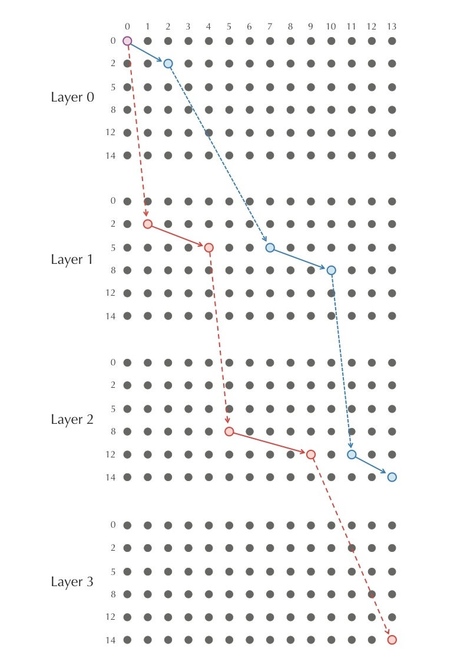
To enforce a limit of at most k modifications, the PSM graph is expanded into a layered spectral alignment graph with k+1 layers.
Each layer represents the number of modifications used so far. Diagonal edges stay within the same layer, while non-diagonal edges move the path to the next layer.
Every path from the source to a node in layer t corresponds to a peptide with exactly t modifications.
Thus, spectral alignment reduces to finding a maximum-weight path in this layered DAG.

Slide 39
From Probability to Spectral Vectors
We model the relationship between a peptide vector P and an observed binary spectrum X using a probabilistic framework. A peptide vector P = (p_1, p_2, ..., p_m) generates a binary vector X = (x_1, x_2, ..., x_m), where each position is produced independently.
The probability of observing X given P is defined as: Pr(X | P) = ∏_{i=1}^{m} Pr(x_i | p_i)
to compare different peptide vectors, we define a likelihood ratio with respect to the all-zero peptide vector 0: Likelihood(X | P) = Pr(X | P) / Pr(X | 0)
To avoid numerical underflow caused by multiplying many small probabilities, we maximize the log-likelihood: log2 Likelihood(X | P) = ∑_{i=1}^{m} log2 ( Pr(x_i | p_i) / Pr(x_i | 0) )
This formulation allows us to convert the binary spectrum into a numerical spectral vector. Each position x_i contributes a fixed spectral score s_i defined as: If x_i = 0: s_i = log2 ( (1 − ρ) / (1 − θ) ) If x_i = 1: s_i = log2 ( ρ / θ )
As a result, the spectrum X is transformed into a spectral vector S = (s_1, s_2, ..., s_m), and identifying the most likely peptide vector reduces to maximizing the total spectral score, which fits naturally into the spectral alignment framework.

Slide 40

We use a probabilistic model to describe how a peptide vector P = (p1, …, pm) generates a binary spectrum X = (x1, …, xm), using two parameters ρ and θ. To avoid numerical underflow caused by multiplying many probabilities, we work with the log-likelihood instead of the likelihood itself.
Each position in the binary vector X is transformed into a spectral vector S, where: - if x_j = 0,
then s_j = log2((1 − ρ) / (1 − θ)) - if x_j = 1, then s_j = log2(ρ / θ)
With this transformation, the log-likelihood becomes a dot product between the peptide vector and the spectral vector: SCORE(P, S) = P · S = p1·s1 + p2·s2 + ... + pm·sm
We define this dot product as the score between a peptide vector and a spectral vector. As a result, finding the most likely peptide vector is equivalent to finding the peptide that maximizes SCORE(P, S). This transforms the Most Likely Peptide Vector Problem into the Peptide Sequencing Problem.

Slide 41
THE END

